Slide 1
Fundamental Forces of Nature

Slide 2
Recap - Everyday Forces
Pushing Forces
Applied force: F_{a}
Pulling Forces
Tension force: F_{T}
Force of gravity: F_{g}
Applied force: F_{a}
Reaction / Oppositional Forces
Friction force: F_{f}
Normal force: F_{N}

Slide 3
The Four Fundamental Forces
Everything in nature can be explained by a combination of one or more of these four forces.
For Example: Friction and the normal force can be explained as effects of the electromagnetic force.
Type of force | Relative Strength | Range | Effect
Gravitational | 1 | infinite | attract only
Electromagnetic | 10²⁰ | infinite | attract / repel
Strong nuclear | 10³⁸ | < 10⁻¹⁵m | attract / repel
Weak nuclear | 10²⁵ | < 10⁻¹⁸ m | attract / repel

Slide 4

Gravitational Force
Classical Understanding
Mass: a fundamental property of all matter
Gravity: attractive force between all matter
Gravity is:
The weakest force
Has infinite range
Is only attractive (is additive)
Recent Discoveries
The relationship between matter and mass is more nuanced (i.e. Higgs Boson confirmed in 2013 by the LHC)

Slide 5
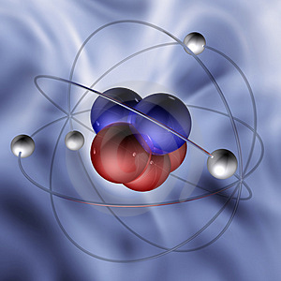
(EM) Electromagnetic Force
Charge: A fundamental property of some matter (e.g. protons and electrons)
EM Force: caused by electrical charges
The EM Force is:
Many magnitudes stronger than gravity
Has Infinite range
Is both attractive and repulsive (cancels)
The EM Force holds atoms and molecules together
ALL CONTACT FORCES ARE DUE TO THE EM FORCE! (e.g. Friction, Applied Force, Normal Force…)

Slide 6

Strong Nuclear Force
The Strong Force holds protons and neutrons together in nucleus
The Strong Force overpowers the repulsive EM Force between protons in the nucleus
Presence of Neutrons helps the Strong Force
The Strong Force is:
The Strongest Force
Has very short range (diameter of a nucleus)
Is Attractive
Atom nucleus

Slide 7
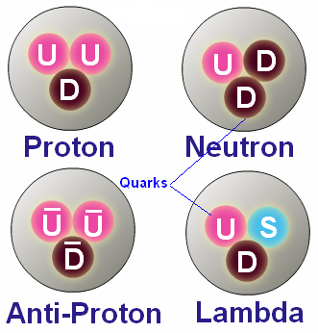
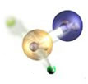
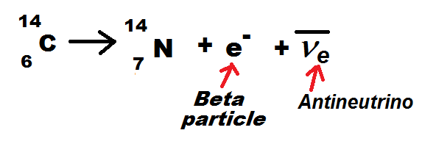
Weak Nuclear Force
Particles like Protons and Neutrons are made up of smaller particles called “quarks”.
The Weak Force holds the quarks together
The Weak Force is responsible for radioactive decay when one element is transformed into another element
e.g. A Proton decays to become a Neutron
The Weak Force is:
The second strongest force
Has extremely short range
Radioactive
decay

Slide 8
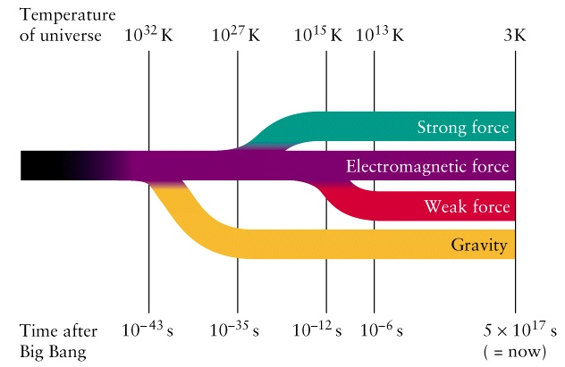
Unification of Forces (The Biggest Challenge of Theoretical Physics)
Relativity (Einstein 1920)
Understanding of gravity
Quantum Physics (Various 1930)
The Most Successful Theory – All our Current Technology
Unifies EM, Strong & Weak Forces into one force at the time of the Big Bang
All attempts to unify Gravity with the other forces has failed.
Theories such as : “String Theory”, “Quantum Gravity” etc.
Reason for building the Large Hadron Collider (LHC)

